Slide 1
Solving simultaneous equations

Slide 2
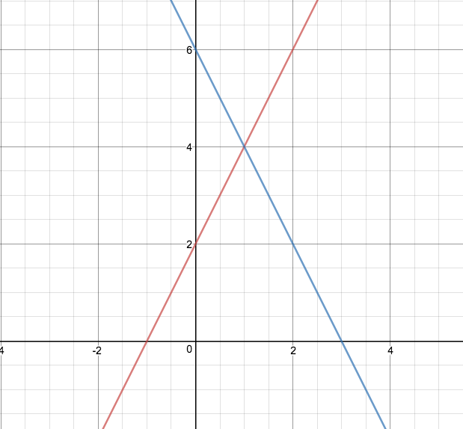
Consider 2 equations:
y = 2x + 2 and y = -2x + 6
Sketch both graphs
There is a point where
the two lines meet.
The point where they meet is the solution to the simultaneous equations.
y = - 2x + 6
y = 2x + 2

Slide 3
Solving simultaneous equations
Possible to solve the simultaneous equation by plotting graphs.
2 algebric methods – substitution and elimination.

Slide 4
Solve y = 2x + 2 and y = -2x + 6 for x and y
y = 2x + 2 (1)
y = -2x + 6 (2)
Substitution
Elimination

Slide 5



Slide 6
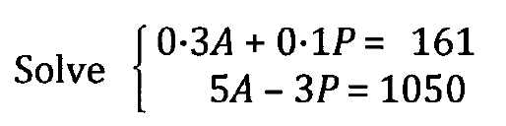

Slide 7
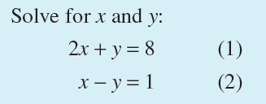
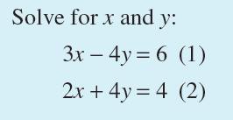

Slide 8
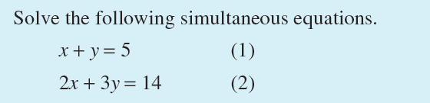

Slide 9
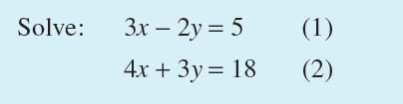

Slide 10
Summary
Substitution method
Make x or y the subject of one equation and substitute into the other equation.
Solve the equation to determine x (or y)
Substitute the value of x (or y) into one of the equation and determine the other value.
Check by substitution into the other equation.
Elimination method
Add or subtract the LHS and RHS of the two equations to eliminate one of the pronumerals.
Solve the equation and then substitute the value determined into the other equation.
Note that the equations may be multiplied by a non-zero constant.

Slide 11
Which one to use?
Usually if you have equations which are of the form
y = ……… or x = ………..
Use substitution.
Otherwise, use elimination.

